Slide 1
Event Ready!
A web application tailored towards new event planners!

Slide 2
Our Team
Kevin Nguyen – nguye5tp@mail.uc.edu
Haneesha Dushara - dusharha@mail.uc.edu
Emilio Sese – seseev@mail.uc.edu
Karthika Ankem – ankemka@mail.uc.edu
Our Faculty Advisor
Dr. Richard Robles – roblesra@ucmail.uc.edu

Slide 3
Project Abstract
This project is designed to assist newcomers to the event planning field. This web application offers an easy-to-use platform that simplifies event management and creation. It provides a range of tools and resources to help aspiring event planners become proficient at organizing and budgeting for various events, making their entry into event planning smoother and more successful.

Slide 4
Purpose & Goal Statement
Project Purpose – The primary purpose of this project is to provide valuable assistance to individuals who are new to event planning. We intend to empower these aspiring event planners with a user-friendly web application that streamlines the process of managing and creating events. By doing so, we aim to significantly enhance their ability to efficiently organize and budget for a wide range of events, making their entry into the world of event planning a more seamless and successful experience.
Goal Statement – To create a fully functional web application that effectively assists stakeholders and users in event management and planning, enabling them to efficiently organize and budget their events.

Slide 5
User Stories
As a student event coordinator, I want to be able to prepare and host an event from start to finish. These steps will include brainstorming, setting goals and frameworks, allocating a budget, determining logistics, advertising, marketing, executing the event, and final debriefing and feedback. I want this application to be a “one-stop-shop” for event planning and execution.

Slide 6
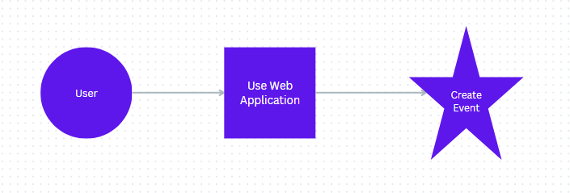

Design Diagram: D0

Slide 7
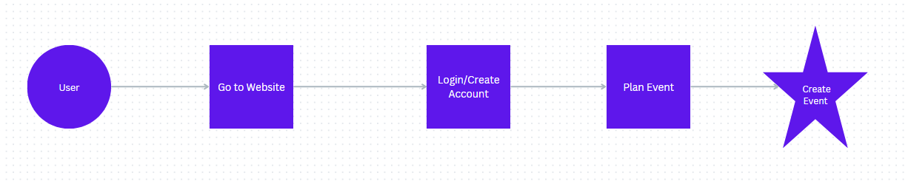
Design Diagram: D1

Slide 8
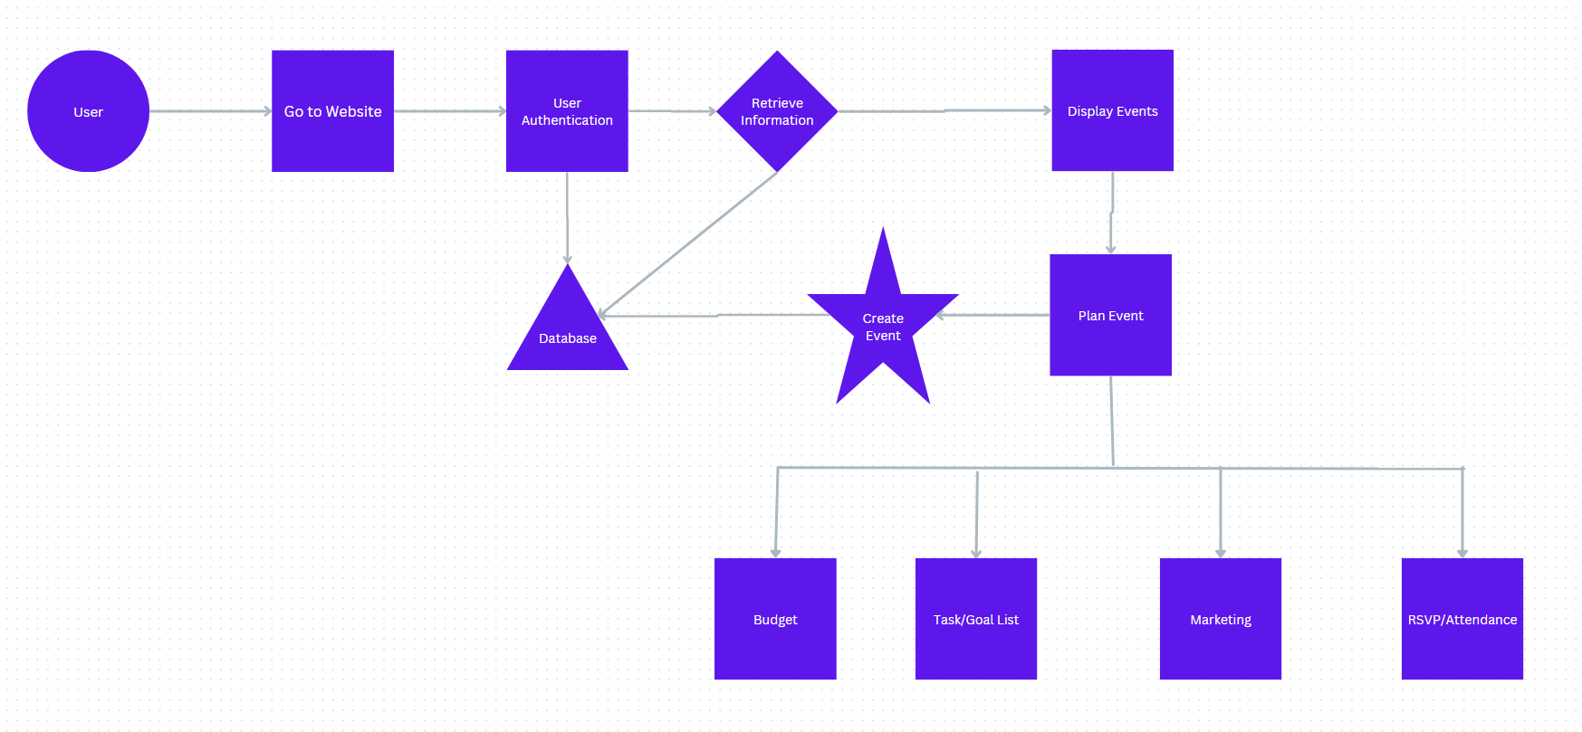
Design Diagram: D2

Slide 9
Project Constraints
Scope
Time
Security
Social
The Scope for our project has been one of the primary challenges so far. Finding the right balance between tailoring features specifically for school organizations and versatile enough to accommodate a wider audience outside this scope is something we have been struggling with. The scope also entails the need to define the app’s core functionalities to meet the unique needs of school organizations or whatever scope we plan on defining in the future. The scope also makes it harder to meet the unique needs of school organizations while ensuring scalability and flexibility for potential expansion to other user groups. Striking this balance will be critical in optimizing user experience and market potential.
Each of the members on our team are full-time students so the difficulty with time comes with trying to handle the many other responsibilities that we have outside of this project while also contributing to this senior design project and completing the tasks that are required. Finding times to meet weekly is troublesome. We may also struggle to include on the features that we decide to implement within the two-semester time frame. We must prioritize the most important ones we decide on based on the data from our surveys.
For security, we are planning on utilizing an authentication process to have users sign in and provide user/pass information to prevent sensitive student organization from being publicized. As developers, we are not so familiar with creating an authentication process for users from scratch, however, we do know that we need to keep these user/pass credentials in a safe database. Depending on scope and how many users use the app, the scale of the database and its security may have to be tweaked.
An important constraint of the project is Social. The project's primary objective is to serve the public and benefit college community, with a focus on aiding Student Organizations. This Event Management app is designed to address the specific challenges faced by these groups in terms of planning events. Student Organizations often comprise volunteers with limited resources and event planning experience. This application aims to empower them by streamlining the event planning process, making it more accessible and efficient. It provides tools and guidance to help students organize and execute successful events, ultimately enhancing their ability to contribute positively to their communities.

Slide 10
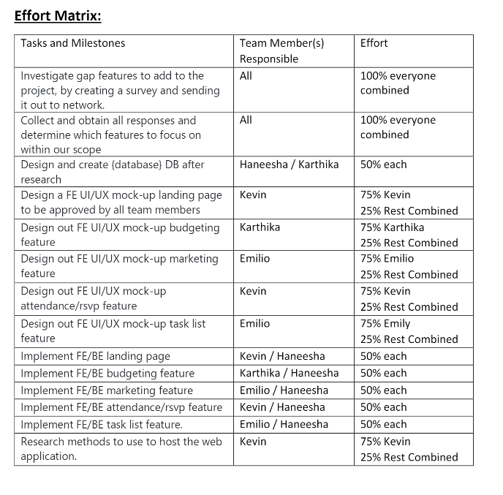
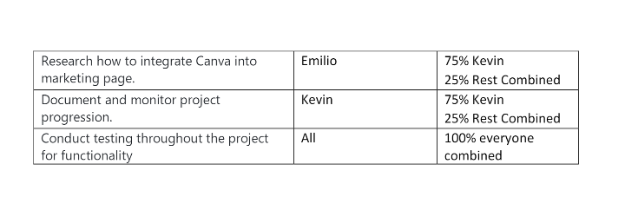
Division of Work

Slide 11
Current Progress
Surveys have been sent out to student organizations and research is being conducted
Project scope is being decided upon based upon the research
Working on UI designs

Slide 12
Expected Accomplishments for this Semester
Finish our research, and finalize scope/features to implement
Complete a mock-up for the design of our UI and different pages
Setup the codebase to prepare for development in the Spring.

Slide 13
Expected Demo at Expo
Billboard/poster
All documentation in a binder
A fully functional web application ran locally on someone's computer(s)

